Slide 1

Smart Environmental Monitoring: Air Quality & Pollution Anomaly Detection Platform
Real-Time & Batch Data Engineering Platform
Name: Onkar Kiran Vallal
Technologies: Apache Kafka, Apache Spark, Cassandra, MySQL, Protobuf, Amazon S3, Play Framework

Slide 2

Problem Statement
Urban Air Quality Challenges
Technical Requirements
Process high-frequency sensor data streams from multiple monitoring stations
Cities face increasing difficulties in monitoring air quality effectively across multiple locations. Traditional systems struggle with the velocity and volume of sensor data, making it hard to identify pollution spikes in real-time.
Detect anomalies and pollution events as they occur
Maintain historical records for trend analysis and compliance reporting
Provide fast access to recent measurements for operational dashboards
Environmental agencies need both immediate alerts for hazardous conditions and historical insights to identify long-term trends and inform policy decisions.

Slide 3
Project Objectives
1
2
Real-Time Data Ingestion
Pollution Anomaly Detection
Continuously capture air quality measurements from distributed sensor networks with minimal latency, ensuring no data loss during peak traffic periods.
Identify unusual pollution patterns and threshold violations in real-time, enabling immediate response to environmental hazards and public health risks.
3
4
Fast Dashboard Access
Long-Term Analytics
Deliver sub-second query performance for operational dashboards displaying current conditions, recent trends, and station status across the monitoring network.
Support comprehensive historical analysis, regulatory reporting, and data science workloads using efficient batch processing and optimized storage formats.

Slide 4
Technology Stack
Component
Technology
Message Broker
Apache Kafka
Stream Processing
Apache Spark Structured Streaming
Batch Processing
Apache Spark SQL
Time-Series Storage
Apache Cassandra
Relational Database
MySQL
Analytics Storage
Amazon S3 with Protobuf
API Framework
Play Framework (Scala)
Sensor Simulation
Akka Actors

Slide 5
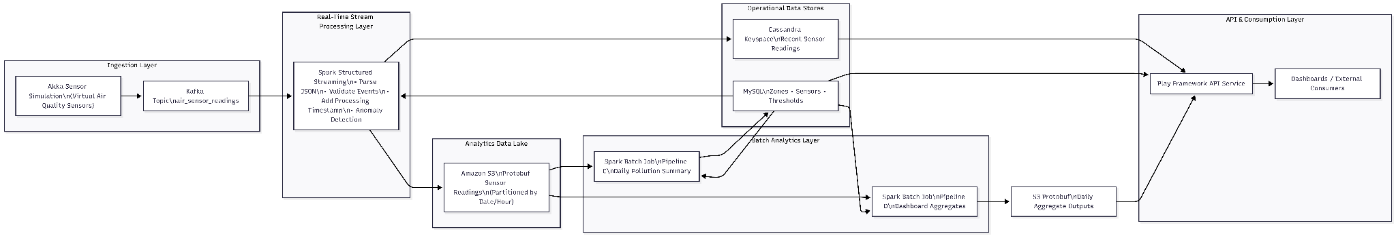
Architecture Overview

Slide 6






Technology Selection Rationale
Apache Kafka
Apache Spark
Provides fault-tolerant message ingestion with high throughput, supporting backpressure handling and replay capabilities essential for streaming architectures.
Unified engine for both streaming and batch processing, reducing operational complexity. Structured APIs simplify development and testing of data pipelines.
Cassandra
MySQL
Optimized for time-series workloads with tunable consistency. Excels at write-heavy operations and provides predictable low-latency reads for recent data queries.
Handles relational operational data like station metadata and daily summaries. ACID compliance ensures data integrity for aggregated metrics and reporting.
S3 & Protobuf
Play Framework
Cost-effective long-term storage with schema evolution support. Protobuf's compact binary format reduces storage costs and improves query performance for analytics.
Reactive, non-blocking API framework built on Akka. Seamlessly integrates with Scala-based data pipelines and provides robust REST endpoint capabilities.

Slide 7
Data Model Overview
MySQL Schema
Cassandra Schema
Protobuf Schema
Operational Tables:
Time-Series Table:
Analytics Storage:
stations – Metadata for monitoring locations
sensor_readings
Strongly-typed message definitions
daily_summaries – Aggregated pollution metrics by day
Partition key: station_id
Efficient serialization
anomaly_events – Detected threshold violations
Clustering key: timestamp (descending)
Schema versioning support
Normalized relational structure supports complex queries and maintains referential integrity.
Optimized for recent data retrieval patterns, supporting dashboard queries with minimal latency.
Stored in S3 with partitioning by date and station for efficient batch processing scans.
S3 Protobuf Files
Station Metadata Exports
Partitioned by Date
Time-series by Station
Station ID
Cassandra Sensor Readings
MySQL Stations

Slide 8

Pipeline A: Sensor Simulation
Pipeline A — Air Sensor Simulation (Akka → Kafka)
Pipeline A simulates thousands of air quality sensors using Akka actors. Each virtual sensor generates PM2.5, PM10, and CO₂ readings every 10 seconds with realistic variations. A small percentage of events include anomaly spikes to mimic real-world pollution incidents. All sensor readings are encoded as JSON and published to the Kafka topic air_sensor_readings for downstream processing.

Slide 9
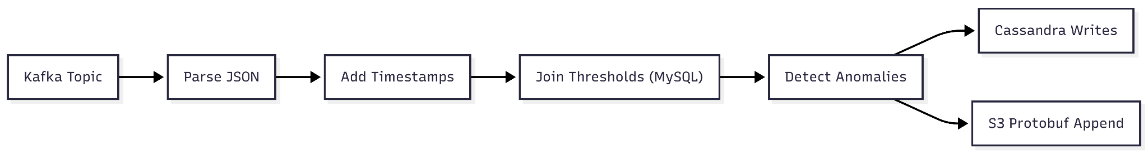
Pipeline B: Real-Time Stream Processing
B
Kafka Consumption
Pipeline B processes real-time air sensor events from Kafka using Spark Structured Streaming.
Incoming JSON messages are parsed, validated, and enriched with processing timestamps.
Sensor readings are compared against zone-specific thresholds stored in MySQL to detect pollution anomalies.
Recent readings are written to Cassandra for fast dashboard access, while the full enriched event stream is stored as Protobuf files in S3 for long-term analytics.

Slide 10

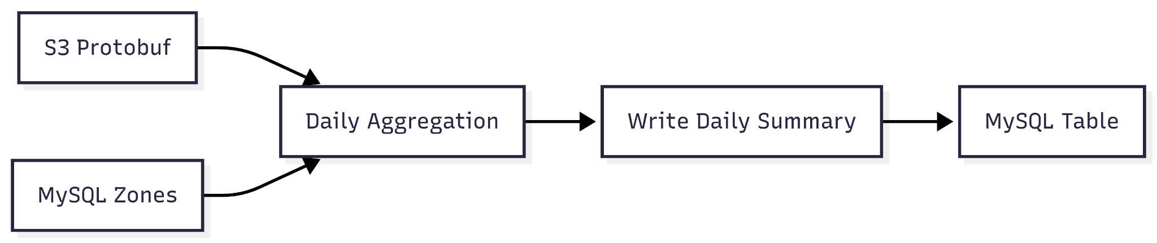
Pipeline C: Daily Pollution Summary
S3 Data Retrieval
Pipeline C is a daily batch job that generates zone-wise pollution summaries.
It reads all Protobuf sensor readings for the day from S3, joins them with zone and threshold data from MySQL, and computes average PM2.5, PM10, CO₂ levels along with anomaly counts.
The aggregated results are stored in the daily_pollution_summary table in MySQL for reporting and compliance analysis.

Slide 11
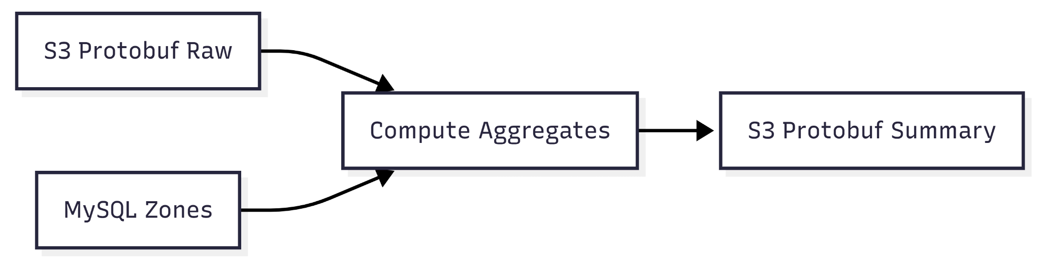
Pipeline D – Dashboard Aggregates
Pipeline D is a batch reporting job that prepares pre-aggregated data for dashboards.
It reads historical Protobuf sensor data from S3 and joins it with zone metadata from MySQL to compute daily averages and anomaly counts.
The results are written as partitioned Protobuf summary tables on S3, which are directly consumed by Play Framework APIs for fast dashboard queries.

Slide 12
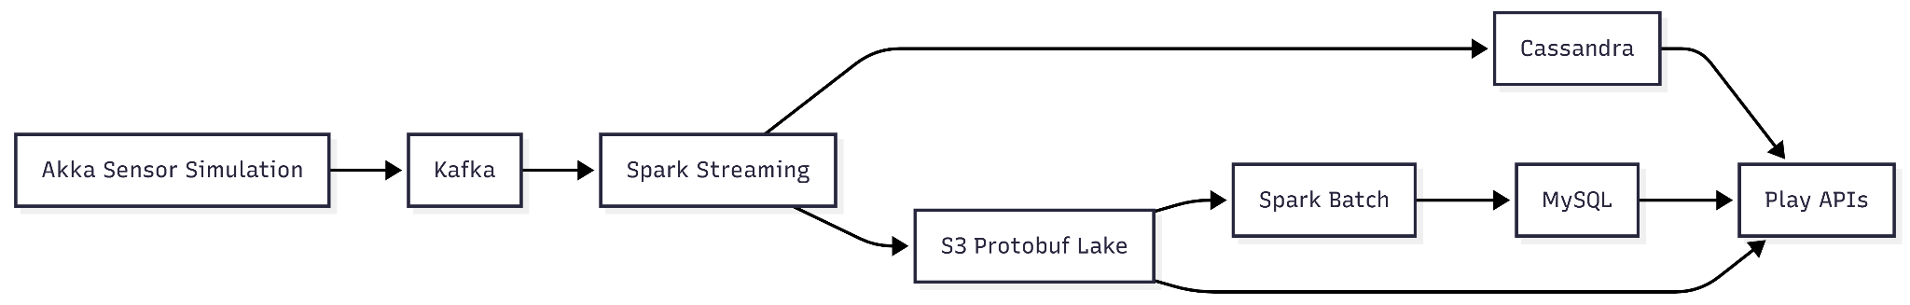
End-to-End Data Flow

Slide 13
API Layer (Play Framework)
REST API Endpoints
Data Source Mapping
The Play Framework powers a comprehensive REST API suite that abstracts backend complexity and provides clean access to processed data:
Real-time APIs: Query Kafka directly via streaming consumers
Aggregated APIs: Fetch from Pipeline D Protobuf store
/api/metrics/realtime – Live streaming data
Historical APIs: Access Parquet data lake via Spark SQL
/api/aggregates/daily – Precomputed summaries
Metadata APIs: Connect to Postgres configuration database
/api/devices/status – Device health monitoring
/api/analytics/trends – Historical trend analysis
Postman collections document all endpoints with example requests and response schemas

Slide 14
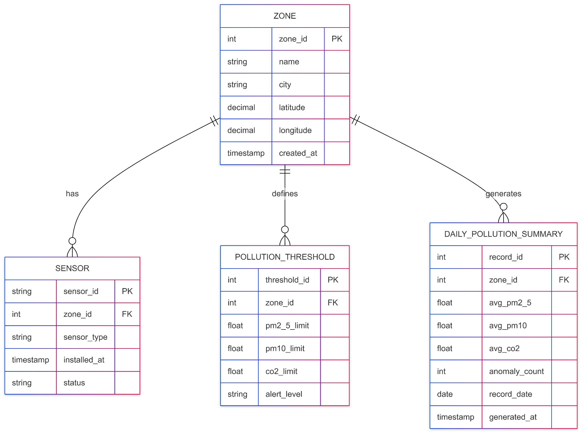
Entity Relationships (MySQL ERD)
Zone → Sensor One zone can have many sensors, but each sensor belongs to only one zone.
Zone → Pollution Threshold One zone can have multiple pollution threshold records, defining acceptable pollution limits.
Zone → Daily Pollution Summary One zone can have many daily summary records, with one record per day capturing average pollution levels and anomaly counts.

Slide 15
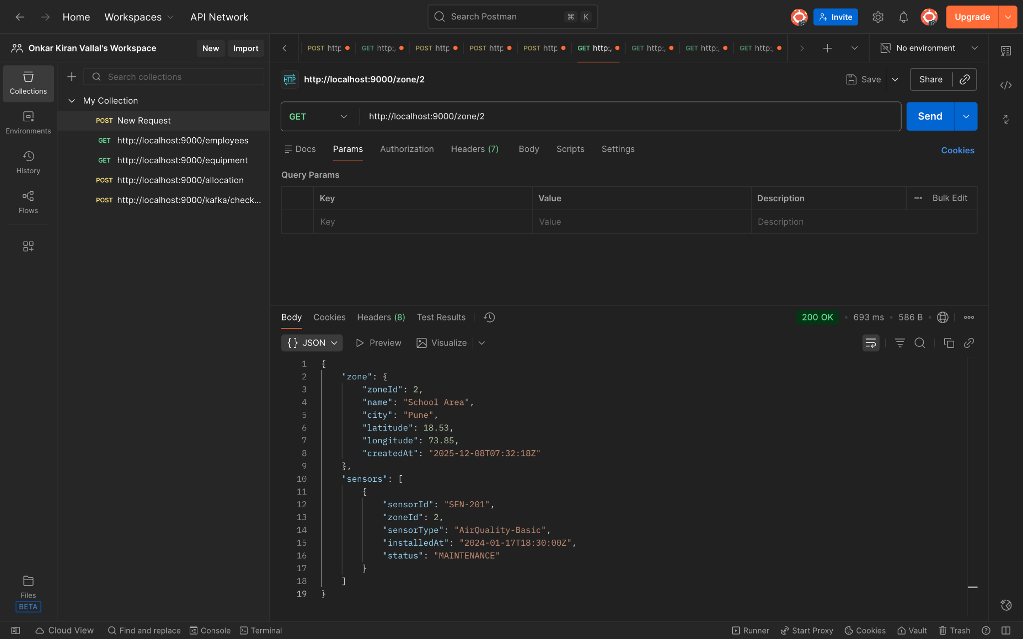

Slide 16
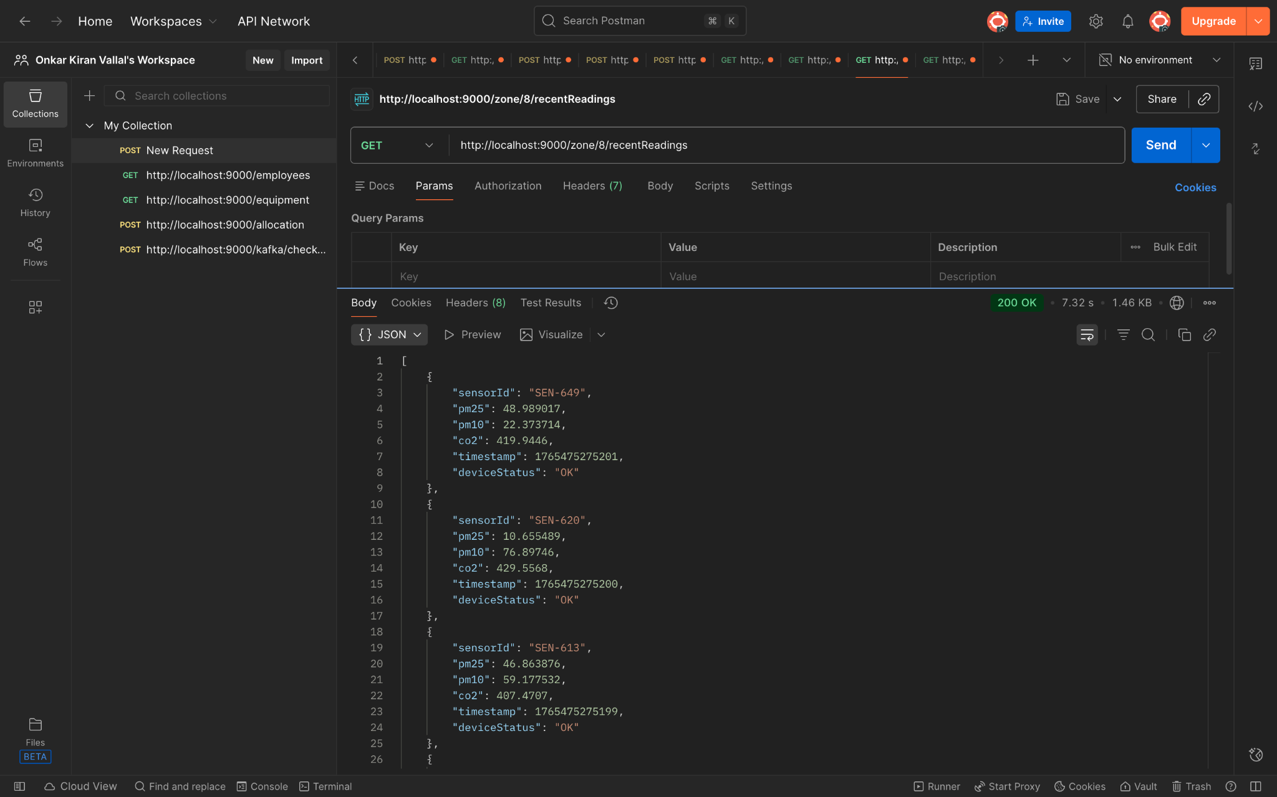

Slide 17
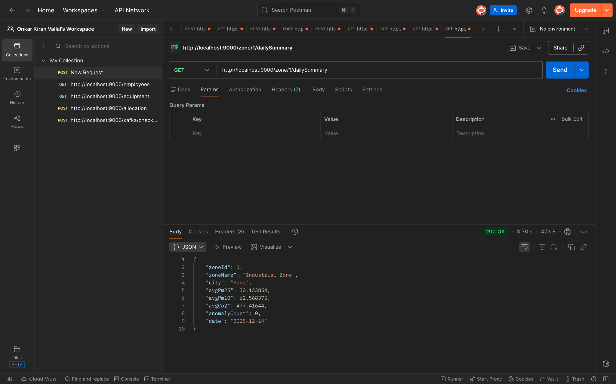

Slide 18
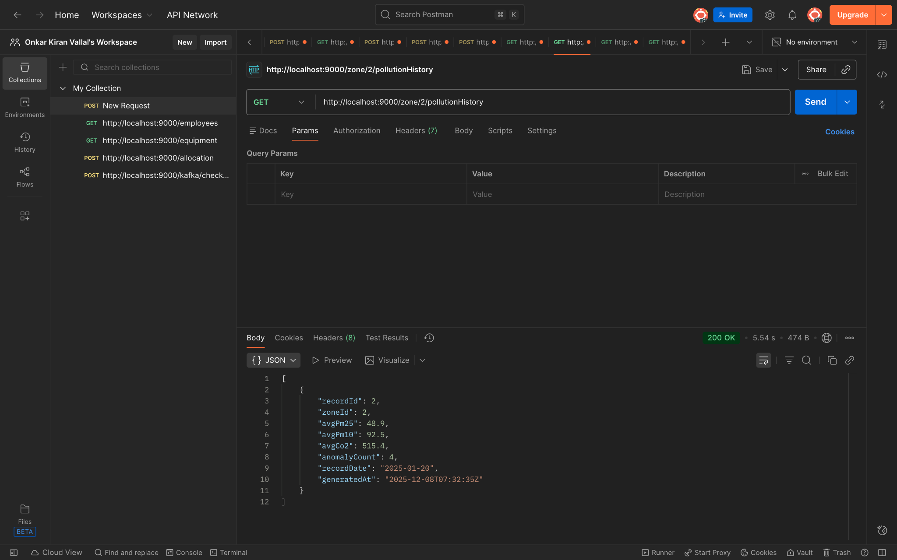

Slide 19
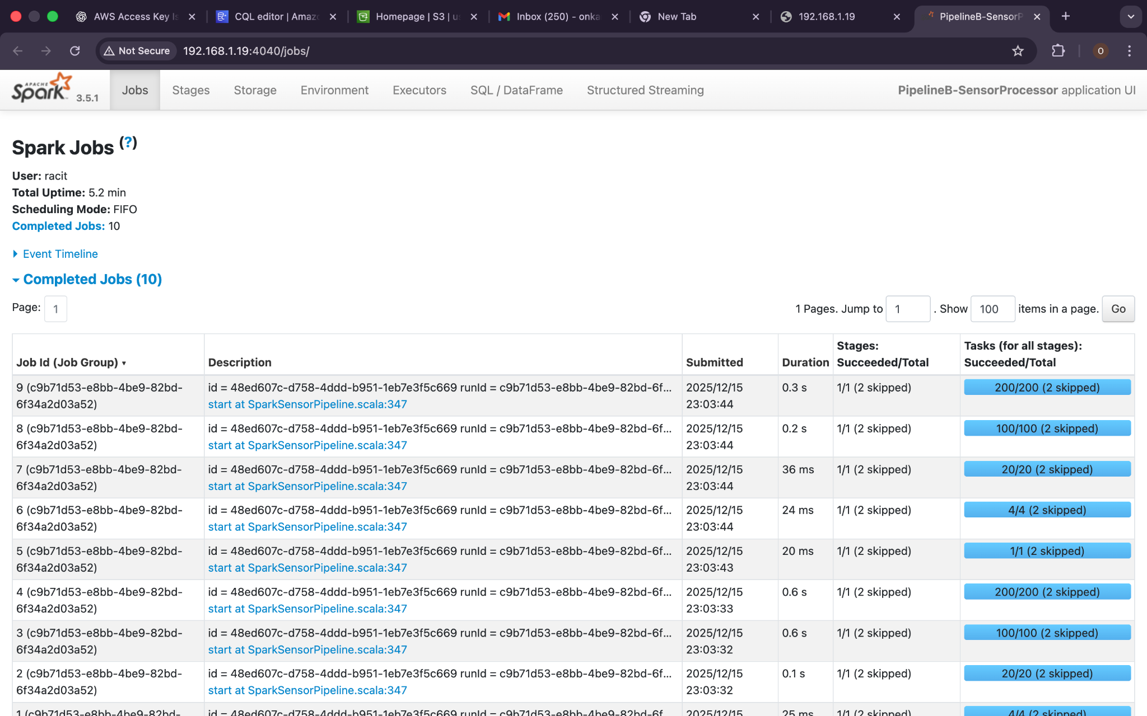

Slide 20
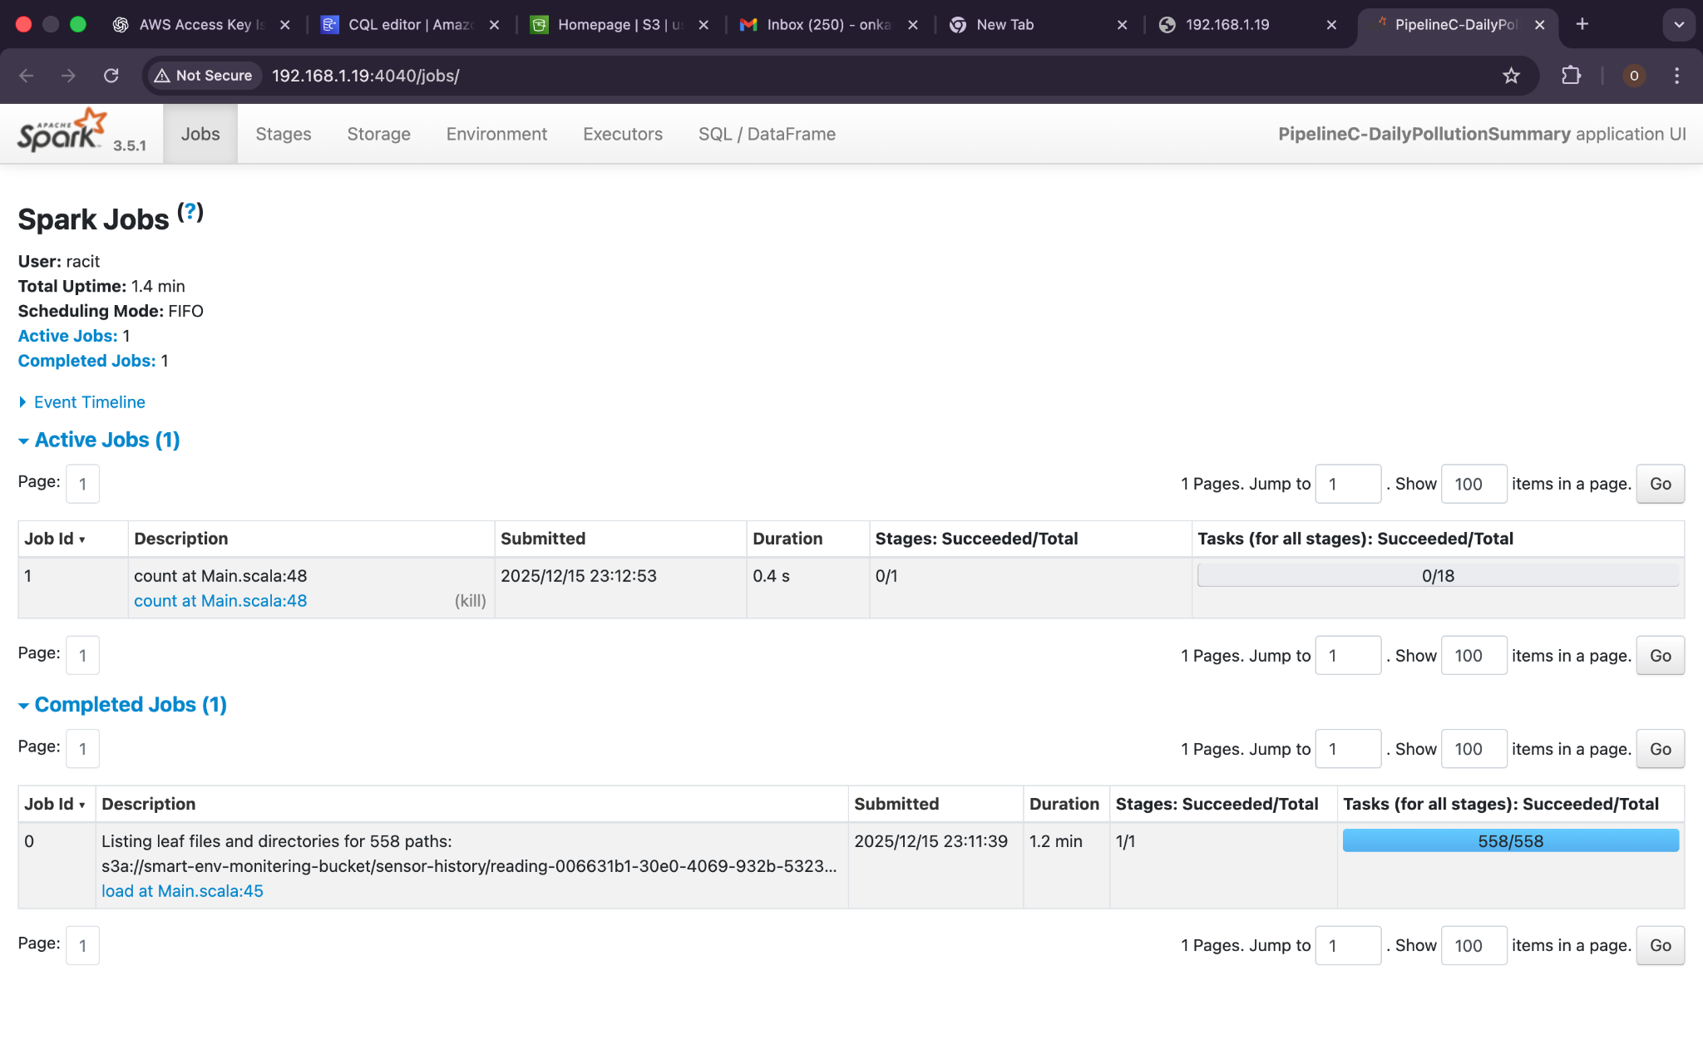

Slide 21
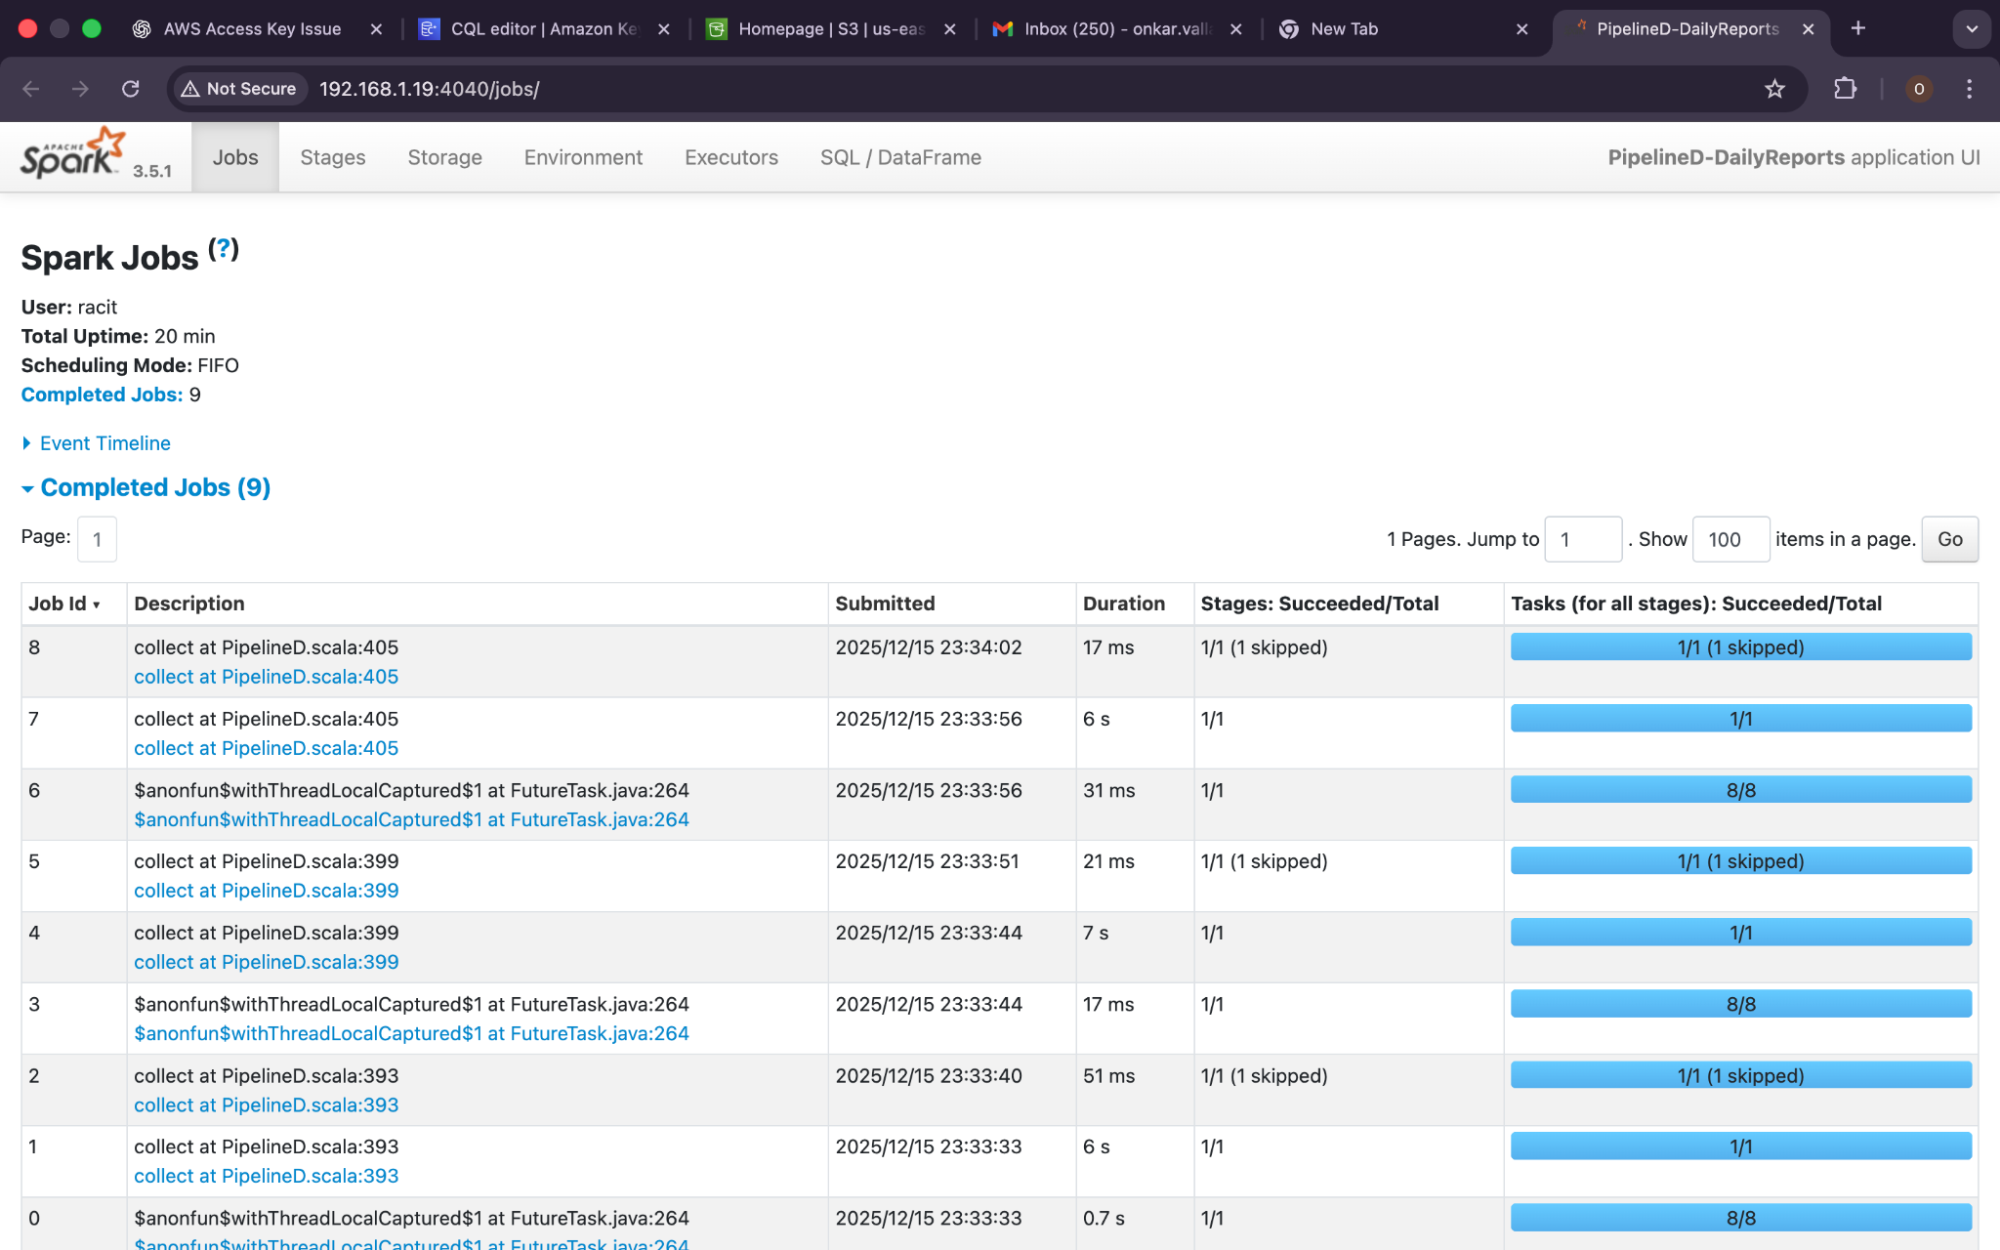

Slide 22

Spark Processing & DAG Overview
Streaming Execution
Join Strategies
Aggregation Stages
Micro-batch processing with Spark Structured Streaming enables near real-time transformations with exactly-once semantics. Watermarking handles late-arriving events gracefully.
Stream-to-stream and stream-to-static joins enrich event data with reference information. Broadcast joins optimize performance for smaller dimension tables.
Multi-level aggregations compute rolling windows, sessionization, and custom metrics. State management ensures accurate cumulative calculations.
Spark UI Insight: The DAG visualization reveals the complete execution plan, showing shuffle operations, stage dependencies, and optimization opportunities for performance tuning.

Slide 23

Performance Considerations
Horizontal Scalability
1
The platform scales linearly by adding Spark executors and Kafka partitions. Auto-scaling policies adjust resources based on ingestion throughput and processing lag metrics.
Throughput Management
2
Optimized batch sizes and parallelism configurations handle peak loads exceeding 100K events/second. Backpressure mechanisms prevent pipeline overload during traffic spikes.
Storage Optimization
3
Columnar Parquet format with Snappy compression reduces storage costs by 70%. Partitioning strategies by date and key dimensions enable efficient query pruning and data lifecycle management.

Slide 24




Key Learnings
Real-Time Architecture
Batch Analytics Design
Mastered event-driven design patterns, including exactly-once processing semantics, stateful stream processing, and window-based aggregations critical for production streaming systems.
Developed expertise in dimensional modeling, incremental batch processing patterns, and efficient partitioning strategies that balance query performance with storage costs.
Schema Evolution
Scalable Patterns
Implemented backward-compatible schema versioning using Avro and Protobuf, enabling zero-downtime deployments and seamless data pipeline upgrades across the platform.
Applied distributed systems principles including horizontal scaling, load balancing, fault tolerance, and monitoring practices essential for production-grade data platforms.

Slide 25

Challenges Faced
Streaming Joins Complexity
Schema Evolution Management
Joining high-velocity streams with varying event-time skew required careful watermark tuning and state TTL configuration. We implemented custom join strategies with late-event handling to maintain data accuracy without excessive memory overhead.
Coordinating schema changes across producers, streaming pipelines, and consumers demanded robust versioning and compatibility testing. Registry integration and automated validation prevented breaking changes from reaching production.
Data Partitioning Strategy
Balancing partition granularity for optimal query performance versus manageable file counts required iterative testing. Dynamic partitioning based on data volume patterns emerged as the most effective solution for mixed workloads.

Slide 26

Future Enhancements
1
Q1: Intelligent Alerting
Deploy rule-based alerting system with configurable thresholds, notification channels, and escalation policies integrated directly into the streaming pipeline.
2
Q2: ML Anomaly Detection
Integrate machine learning models for real-time anomaly detection, leveraging historical patterns to identify unusual behavior and predict potential system failures.
3
Q3: Data Lake Optimization
Implement Delta Lake for ACID transactions, time travel capabilities, and improved query performance through advanced indexing and caching strategies.

Slide 27

Thank You

